Slide 1
Accelerating Systems with Programmable Logic Components Lecture 05 Verilog III
1DT109 ASPLOC
2022 VT1-VT2
Yuan Yao, yuan.yao@it.uu.se

Slide 2
Agenda
Conditional statement
If-else statement
The “: ?” conditional operator
Case statement
Finite state machine (FSM)
A mini project
We will do it together

Slide 3
Conditional statement
If-else statement
The “: ?” conditional operator
Case statement

Slide 4
If-else statement
The if-else statement is used to determine whether the statements within the if/else block should be executed.
If the expression evaluates to true,
any non-zero value,
all statements within that if block will be executed.
If the expression evaluates to false,
0 or ‘X’ or ‘Z’,
the statements within that if block will not be executed.
If there is an else statement and the expression is false then the statements within the else block will be executed (the “default” case).
Syntax is very similar to C if statement. But behaviors are very different.

Slide 5
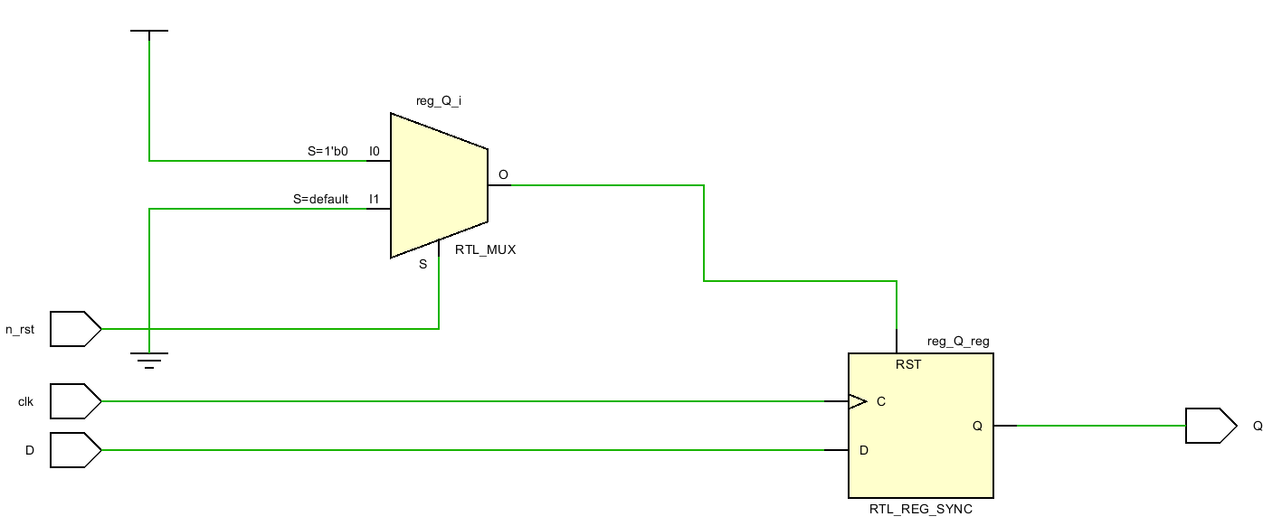
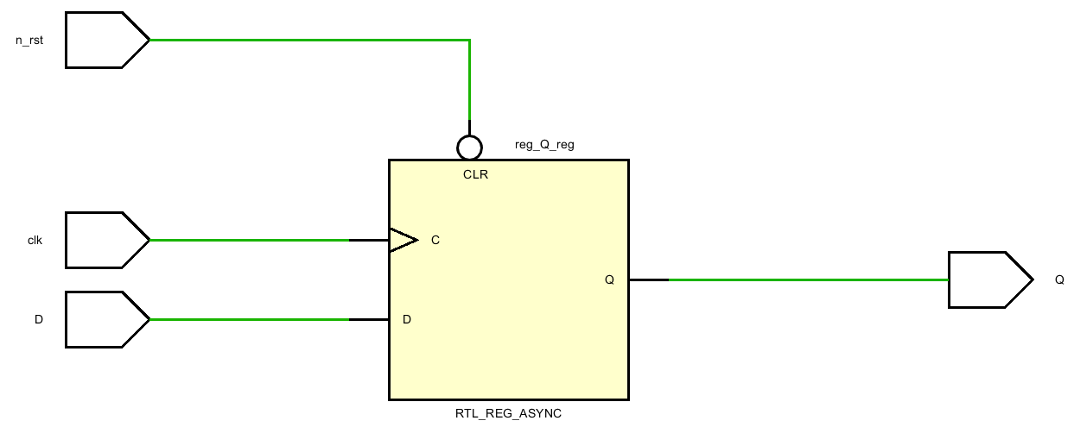

If-else statement
module demo_1(
input D, clk, n_rst,
output Q);
reg reg_Q;
assign Q = reg_Q;
always @ (posedge clk) begin
if(!n_rst)
reg_Q <= 1'b0;
else
reg_Q <= D;
end
endmodule
module demo_2(
input D, clk, n_rst,
output Q);
reg reg_Q;
assign Q = reg_Q;
always @ (posedge clk,
negedge n_rst) begin
if(!n_rst)
reg_Q <= 1'b0;
else
reg_Q <= D;
end
endmodule
module demo_3(
input D, clk, rst,
output Q);
reg reg_Q;
assign Q = reg_Q;
always @ (posedge clk,
posedge rst) begin
if(rst)
reg_Q <= 1'b0;
else
reg_Q <= D;
end
endmodule

Slide 6
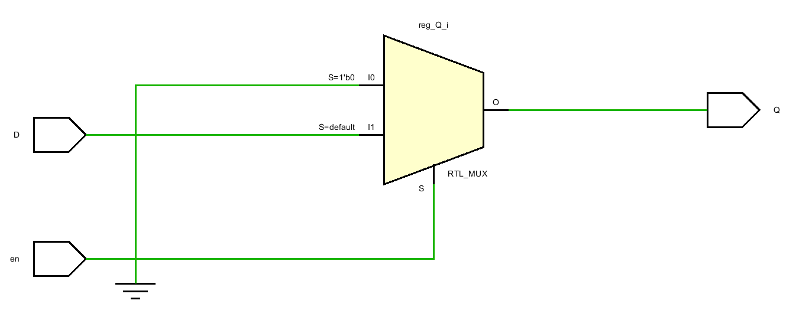
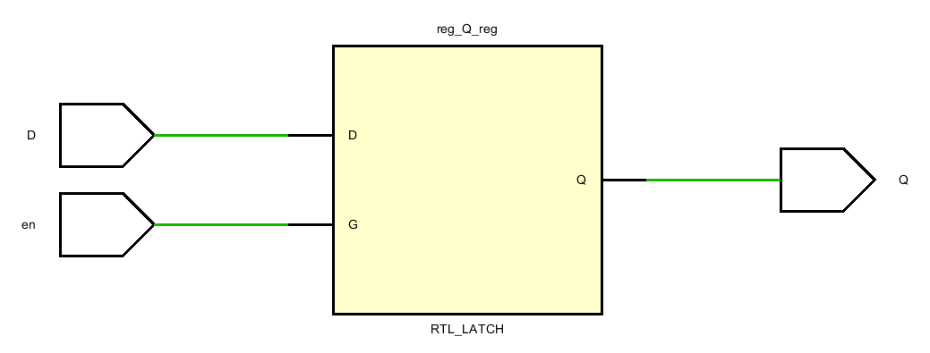
If-else statement
module demo_4(
input D, en,
output Q);
reg reg_Q;
assign Q = reg_Q;
always @ (D, en) begin
if(!en)
reg_Q = 1'b0;
else
reg_Q = D;
end
endmodule
module demo_5(
input D, en,
output Q);
reg reg_Q;
assign Q = reg_Q;
always @ (D, en) begin
if(en)
reg_Q = D;
end
endmodule
Rules of thumb No.7:
Always enclose an if with an else to
avoid auto-generated latch.
If enabled, the output follows the input.
Otherwise, the output holds the old value.
If enabled, the output follows the input.
Otherwise, the output is reset to 0.

Slide 7
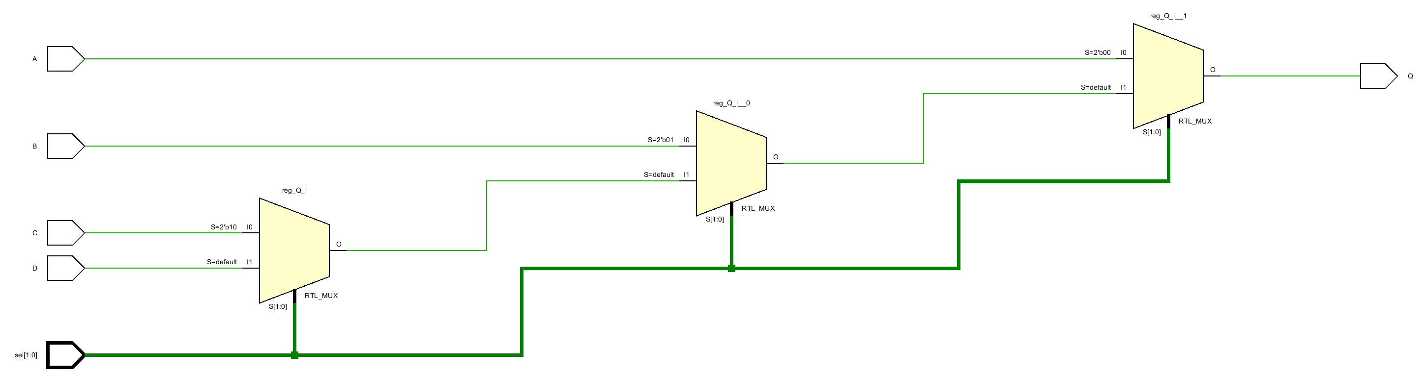
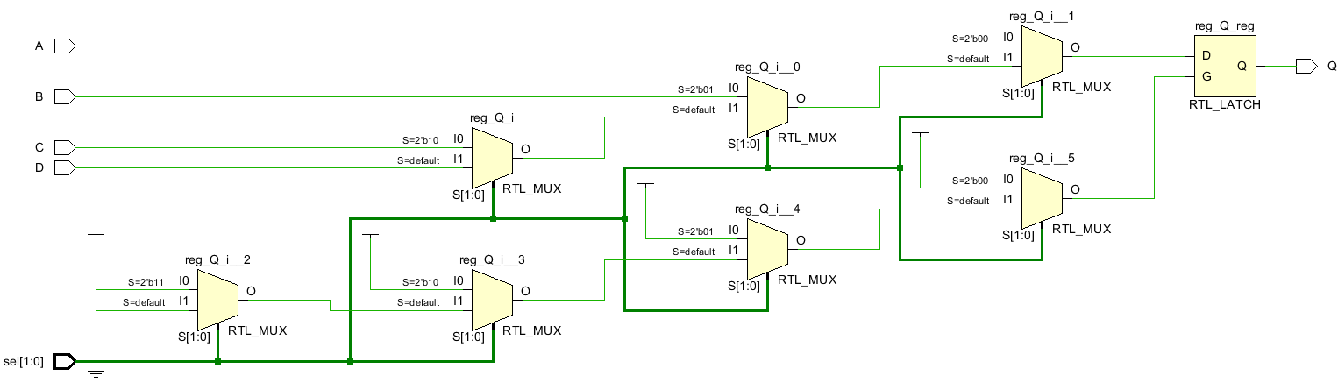
Let’s play some tricks
module demo_6 (
input [1:0] sel,
input A, B, C, D,
output Q);
reg reg_Q;
assign Q = reg_Q;
always @ (A, B, C, D, sel) begin
if (sel == 2'b00)
reg_Q = A;
else if (sel == 2'b01)
reg_Q = B;
else if (sel == 2'b10)
reg_Q = C;
else
reg_Q = D;
end
endmodule
… // demo_7
always @ (A, B, C, D, sel) begin
if (sel == 2'b00)
reg_Q = A;
else if (sel == 2'b01)
reg_Q = B;
else if (sel == 2'b10)
reg_Q = C;
else if (sel == 2’b11)
reg_Q = D;
end
endmodule
Always enclose an if with an else to
avoid auto-generated latch.
Equivalent as before?

Slide 8
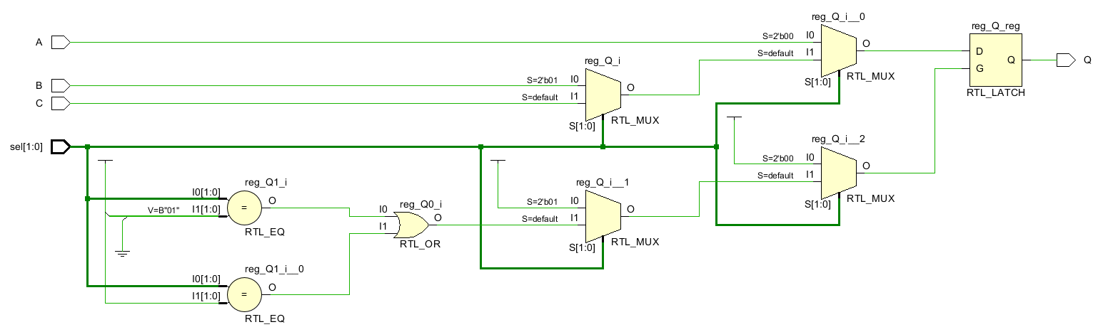
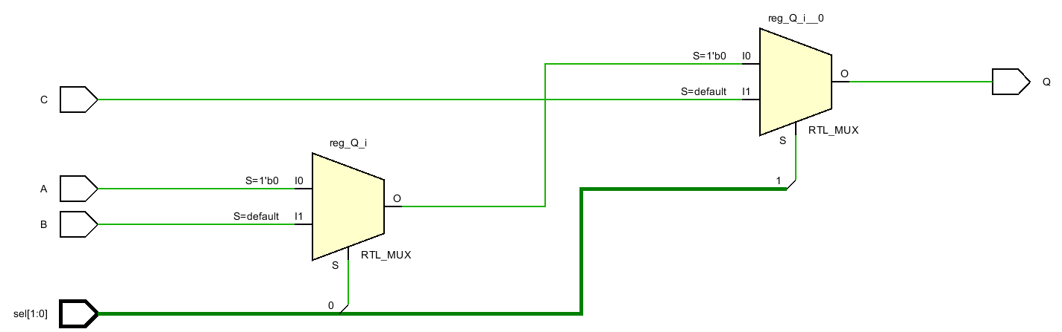
Nested if-else statement
What if we want to do:
Q = A when sel == 00
Q = B when sel == 01
Q = C when all other cases
Way 1 (demo_8)
Way 2 (demo_9)
Bad style (demo_10)
always @ (A, B, C, sel) begin
if (sel == 1'b00)
reg_Q = A;
else if (sel == 1'b01)
reg_Q = B;
else
reg_Q = C;
end
always @ (A, B, C, sel) begin
if (sel[1] == 1'b0)
if (sel[0] == 1'b0)
reg_Q = A;
else
reg_Q = B;
else
reg_Q = C;
end
always @ (A, B, C, sel) begin
if (sel == 1'b00)
reg_Q = A;
else if (sel == 1'b01)
reg_Q = B;
else if (sel == 1’b10 || sel == 1’b11 )
reg_Q = C;
end

Slide 9
The depth of an if-else (3-8 decoder)
always @ (in) begin
if (in == 3'b000)
reg_out = 8'h0_1;
else if (in == 3'b001)
reg_out = 8'h0_2;
else if (in == 3'b010)
reg_out = 8'h0_4;
else if (in == 3'b011)
reg_out = 8'h0_8;
else if (in == 3'b100)
reg_out = 8'h1_0;
else if (in == 3'b101)
reg_out = 8'h2_0;
else if (in == 3'b110)
reg_out = 8'h4_0;
else
reg_out = 8'h8_0;
end // demo_11
If-else statement implicitly implies a priority-based decoding process.
The first if statement is checked first.
Short data path.
Run fast.
The last if statement is checked last.
Long data path.
Run slow.
Performance of the circuit depends on input.
Rules of thumb No.8:
Don’t write deep if-else.
Note the ROM.
How to improve?

Slide 10
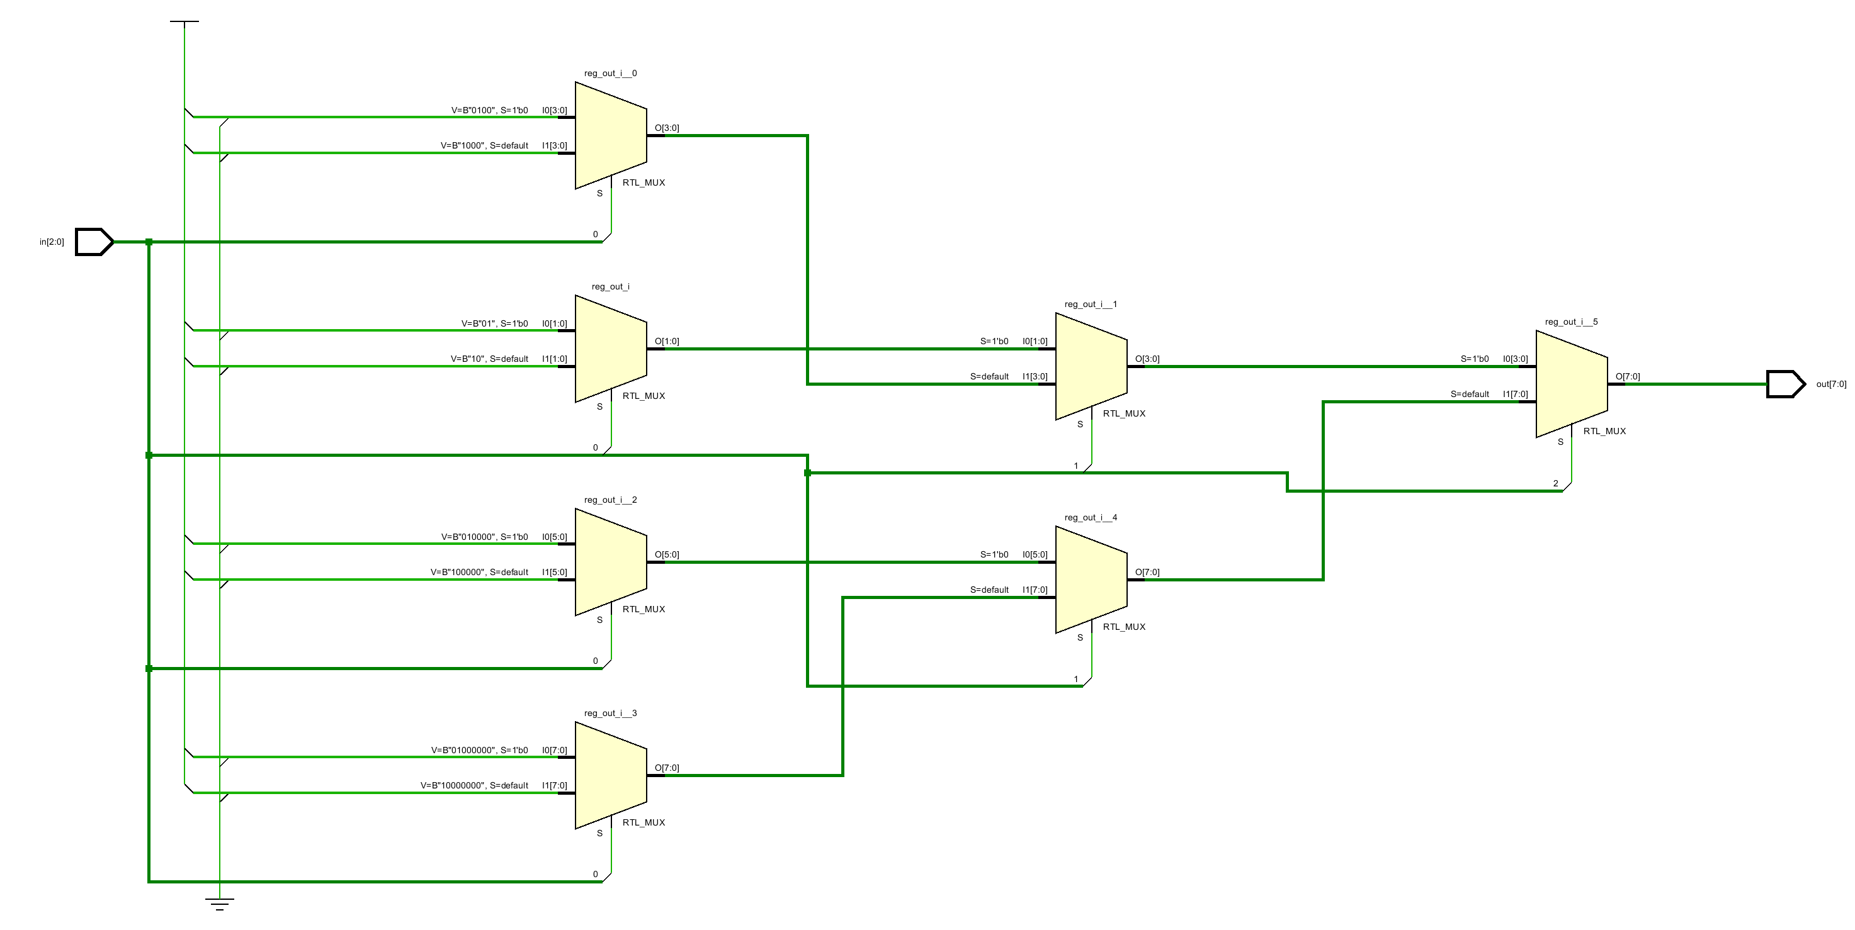
Improve deep if-else
always @ (in) begin
if (in[2] == 1'b0)
if(in[1] == 1'b0)
if(in[0] == 1'b0)
reg_out = 8'h0_1;
else
reg_out = 8'h0_2;
else // in[1] == 1’b1
if(in[0] == 1'b0)
reg_out = 8'h0_4;
else
reg_out = 8'h0_8;
else
if(in[1] == 1'b0)
if(in[0] == 1'b0)
reg_out = 8'h1_0;
else
reg_out = 8'h2_0;
else // in[1] == 1’b1
if(in[0] == 1'b0)
reg_out = 8'h4_0;
else
reg_out = 8'h8_0;
end //demo_12
Insight: balance the HW structure.
3’b000 → 8’h01
3’b001 → 8’h02
3’b010 → 8’h04
3’b011 → 8’h08
3’b100 → 8’h10
3’b101 → 8’h20
3’b110 → 8’h40
3’b111 → 8’h80
Balanced data-path, no ROM.
Hard to tune. Not always possible to balance.
in[1]=0
in[2]=0
Use case statement.
in[1]=1
in[1]=0
in[2]=1
in[1]=1

Slide 11
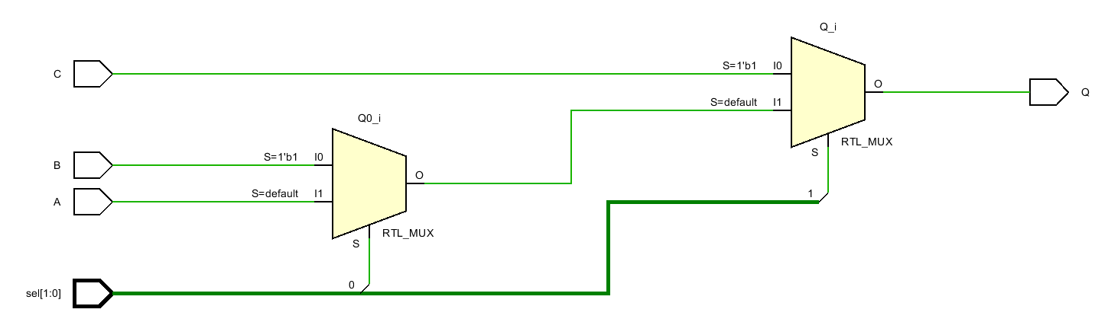
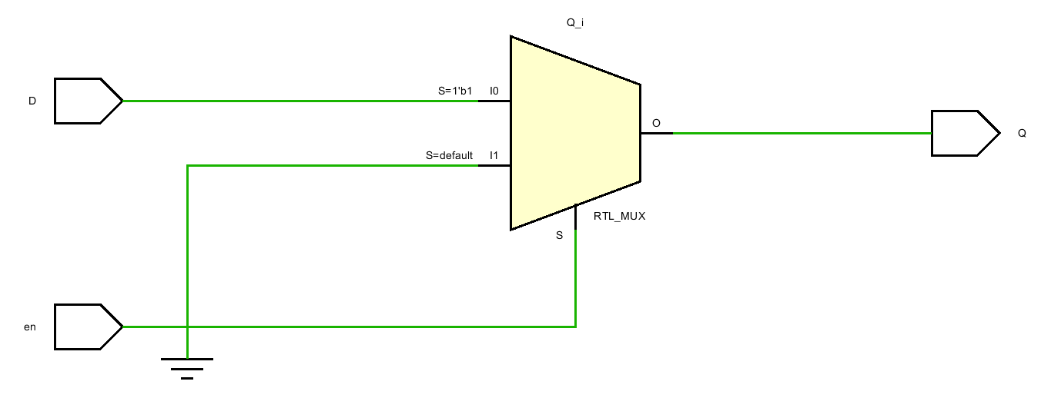
The “: ?” conditional operator
demo_4
demo_9
Also called as inline if.
Syntax
condition ? value_if_true : value_if_false
… // demo_4
always @ (D, en) begin
if(!en)
reg_Q = 1'b0;
else
reg_Q = D;
end
… // demo_9
always @ (A, B, C, sel) begin
if (sel == 1'b00)
reg_Q = A;
else if (sel == 1'b01)
reg_Q = B;
else
reg_Q = C;
end
… // demo_13
assign Q = en ? D : 1’b0;
endmodule
demo_12
demo_11
… // demo_14
assign Q = sel[1] ? C : (sel[0] ? B : A);
endmodule

Slide 12
Case statement
The case statement checks if the given expression matches one among the case branches.
If none of the case matches the given expression, statements within the default branch are evaluated.
If expression matches case_branch_4 then C1 and C2 in the begin-end block are evaluated sequentially
If expression matches case_branch_1 then A is evaluated
case (expression)
case_branch_1 : A
case_branch_2,
case_branch_3 : B
case_branch_4 :
begin
C1, C2
end
default: D
endcase
If expression matches case_branch_2 or case_branch_3 then B is evaluated
If none of the above matches, D in the default branch is evaluated.

Slide 13
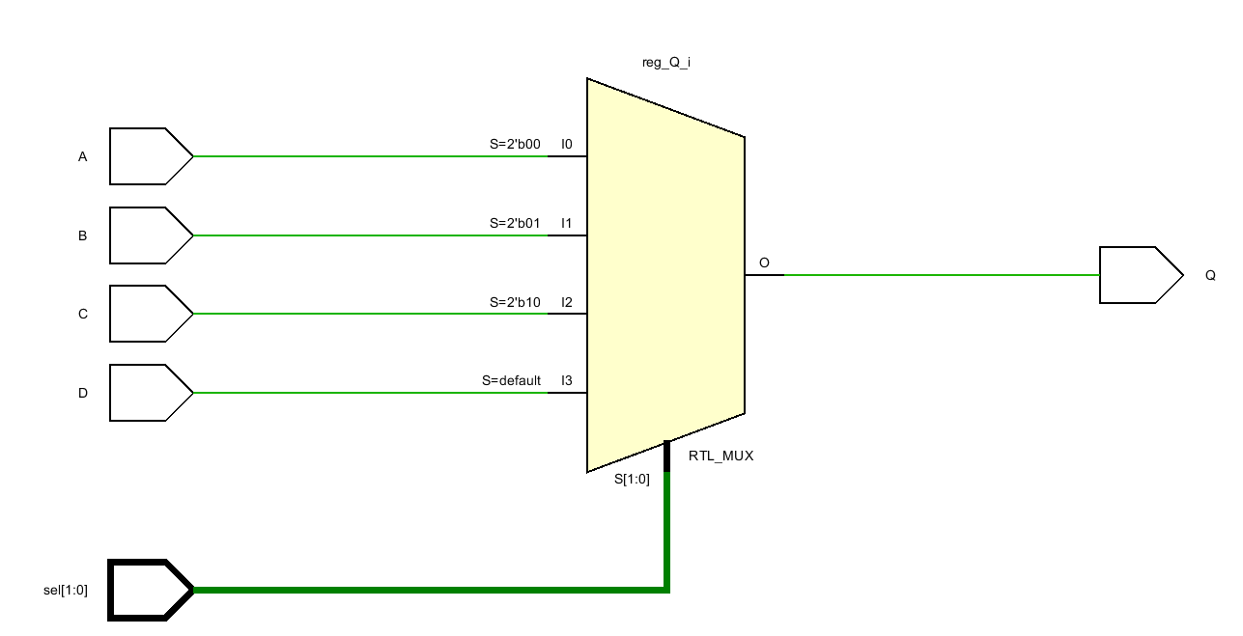
Case statement
module demo_15 (
input [1:0] sel,
input A, B, C, D,
output Q);
reg reg_Q;
assign Q = reg_Q;
always @ (A, B, C, D, sel) begin
case (sel)
2'b00:
reg_Q = A;
2'b01:
reg_Q = B;
2'b10:
reg_Q = C;
default:
reg_Q = D;
endcase
end
endmodule
module demo_15 (
input [1:0] sel,
input A, B, C, D,
output Q);
reg reg_Q;
assign Q = reg_Q;
always @ (A, B, C, D, sel) begin
case (sel)
2'b00:
reg_Q = A;
2'b01:
reg_Q = B;
2'b10:
reg_Q = C;
2’b11:
reg_Q = D;
endcase
end
endmodule
module demo_6 (
input [1:0] sel,
input A, B, C, D,
output Q);
reg reg_Q;
assign Q = reg_Q;
always @ (A, B, C, D, sel) begin
if (sel == 2'b00)
reg_Q = A;
else if (sel == 2'b01)
reg_Q = B;
else if (sel == 2'b10)
reg_Q = C;
else
reg_Q = D;
end
endmodule
Using if-else
Equivalent
Using case

Slide 14
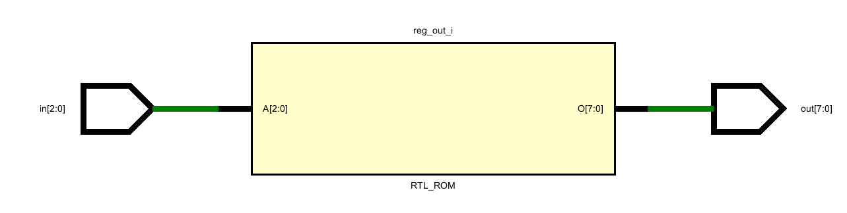

The depth of a case (3-8 decoder)
always @ (in) begin
case (in)
3'b000: reg_out = 8'h01;
3'b001: reg_out = 8'h02;
3'b010: reg_out = 8'h04;
3'b011: reg_out = 8'h08;
3'b100: reg_out = 8'h10;
3'b101: reg_out = 8'h20;
3'b110: reg_out = 8'h40;
default: reg_out = 8'h80;
endcase
end

Slide 15
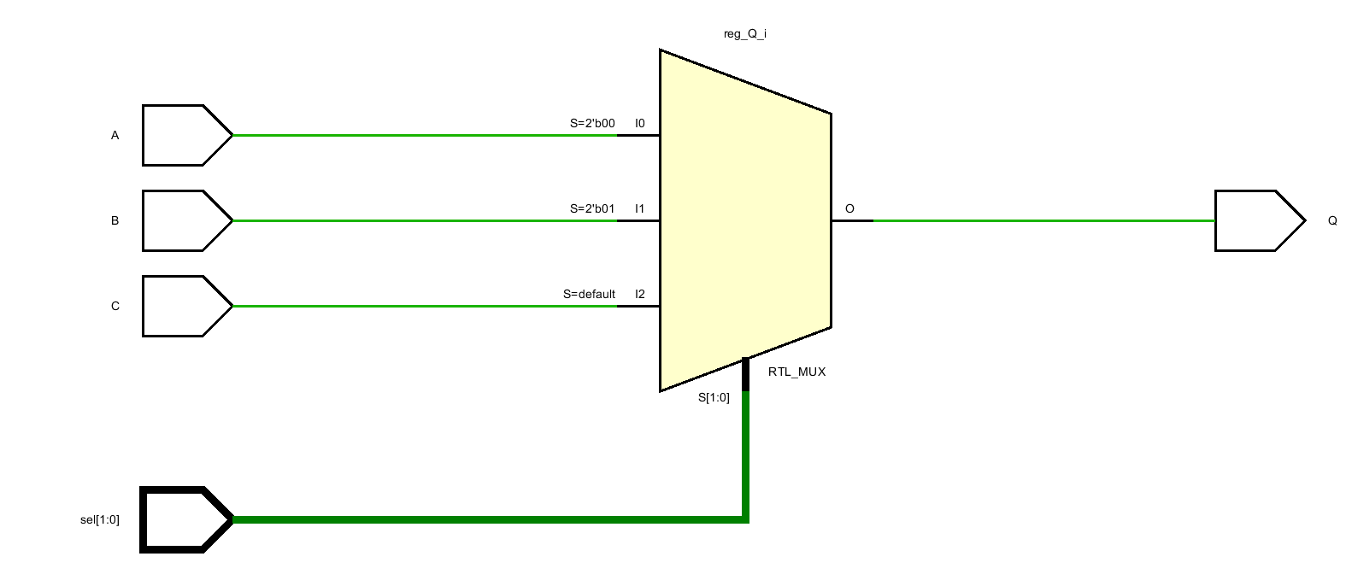
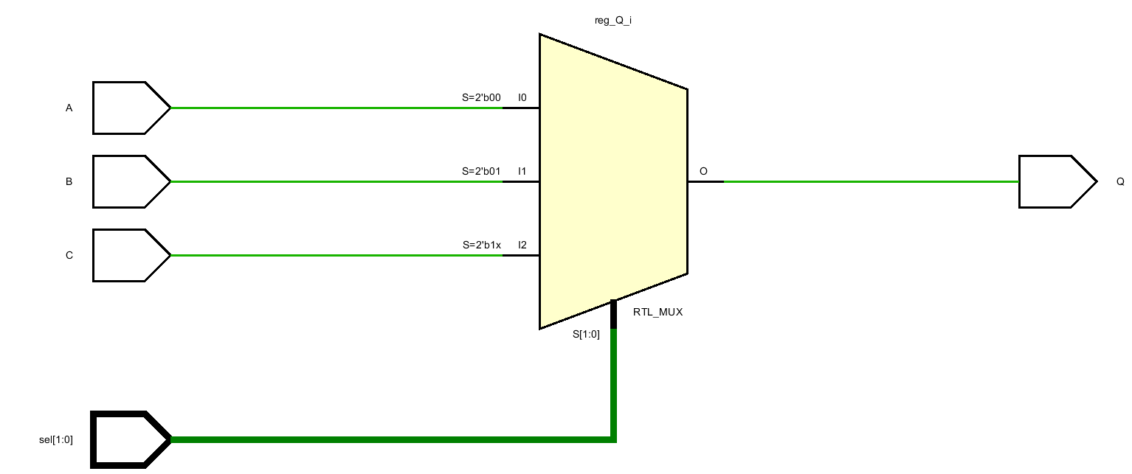
The don’t-care “?” in case statement
demo_8
demo_16
demo_16
always @ (A, B, C, sel) begin
if (sel == 1'b00)
reg_Q = A;
else if (sel == 1'b01)
reg_Q = B;
else
reg_Q = C;
end
always @ (A, B, C, sel) begin
case(sel)
2'b00:
reg_Q = A;
2'b01:
reg_Q = B;
default:
reg_Q = C;
endcase
end
always @ (A, B, C, sel) begin
casex(sel) // or casez(sel)
2'b00:
reg_Q = A;
2'b01:
reg_Q = B;
2’b1?: // for both ’10’ and ’11’
reg_Q = C;
endcase
end

Slide 16
Case, casez, casex
In Verilog, casez and casex are special case statement.
In casez ‘Z’ and ‘?’ are treated as don’t-care in both case expression and case branch
In casex ‘Z’, ‘X’ and ‘?’ are treated as don’t-care in both case expression and case branch
In case ‘1’, ‘0’, ‘X’, ‘Z’ are treated as four different values Don’t use don’t-care in case, use them in casez/casex
In casez and casex, if multiple case branches matches the expression, the first match dominates.

Slide 17
Examples: case, casex, casez
reg sel = 1'bZ;
initial begin
case(sel)
1'b0:
$display("A");
1'b1:
$display("B");
1'bZ:
$display("C");
1'bX:
$display("D");
default:
$display("default");
endcase
end //demo_17
C
reg sel = 1'bX;
initial begin
casez(sel)
1'b0:
$display("A");
1'b1:
$display("B");
1’bZ:
$display("C");
1’b?:
$display("D");
1'bX:
$display("E");
default:
$display("default");
endcase
end //demo_18
C
reg sel = 1'bX;
initial begin
casez(sel)
1'b0:
$display("A");
1'b1:
$display("B");
1'bX:
$display("C");
1'bZ:
$display("D");
1'b?:
$display("E");
default:
$display("default");
endcase
end //demo_19
C
reg sel = 1'bZ;
initial begin
casez(sel)
1'b0:
$display("A");
1'b1:
$display("B");
1'bX:
$display("C");
1'bZ:
$display("D");
1'b?:
$display("E");
default:
$display("default");
endcase
end //demo_20
A
reg sel = 1'bX;
initial begin
casex(sel)
1'b0:
$display("A");
1'b1:
$display("B");
1'bX:
$display("C");
1'bZ:
$display("D");
1'b?:
$display("E");
default:
$display("default");
endcase
end //demo_21
A
All don’t-cares are non-synthesizable.

Slide 18
Examples: case, casex, casez
reg sel = 1'bX;
always @ (sel) begin
casex(sel)
1'b0:
$display("A");
1'b1:
$display("B");
1'bX:
$display("C");
1'bZ:
$display("D");
1'b?:
$display("E");
default:
$display("default");
endcase
end //demo_22
always doesn’t trigger
Default value is indeed ‘X’.

Slide 19
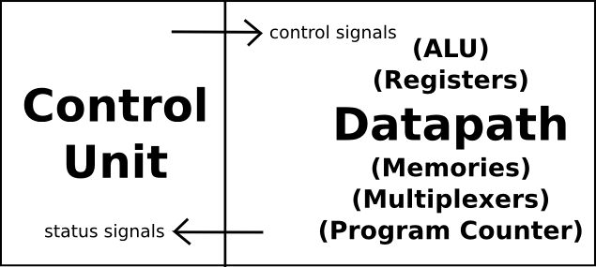
Finite state machines
A digital system can generally be divided into control unit and datapath.
For example, in a processor circuit:

Slide 20
Finite state machines
FSM is a method to model control logic.
An FSM consists of combinational, sequential and output logic.
The combinational logic is used to decide the next state of the FSM.
The sequential logic is used to store the current state of the FSM.
The output logic is used to generate output based on the current state of the FSM.
Without taking the input → Type Moore
With input (green line) → Type Mealy
Next state
Logic
Current state
Logic
Output Logic
D_FF
D
Q
D_FF
output
D
Q
input
clk
clk
clk

Slide 21
How to design an FSM
Specification analysis
Create state diagrams
Choose type Moore or Mealy
Minimize state diagram using Karnaugh map (out of scope here)
Assign codes for states
One-hot? Binary? Gray code?
Design seq-logic for storing the next state
Design the output logic
May use both combi- and seq-logic for output generation
Design combi-logic for calculating the next state
Core of the FSM

Slide 22

FSM Mini project – Traffic light control

Slide 23

Specification
Traffic
light 2 with car sensor
Oscar wants a system containing two traffic lights, governing a junction of two (one-way) streets.
In the default case, traffic light 1 is green, traffic light 2 is red.
When a car is detected at traffic light 2, the system switches traffic light 1 to red, light 2 to green, waits some amount of time for the car to pass.
Then the system switches back to the default situation.
Traffic
light 1

Slide 24

Specification analysis
First thing first, how traffic light works?
Traffic lights change their colors in the same order every time.
Red light on: This tells drivers to stop.
Green light on: This means the driver can start driving or keep driving.
Yellow light on: This tells drivers to stop when it is safe to, because the light is about to turn red.
In our case:
Car comes
Light 1: Green → Yellow → Red
Light 2: Red (wait) → Green
2
1
Car leaves
Light 1: Red (wait) → Green
Light 2: Green → Yellow → Red
T

Slide 25
Create state diagrams
S2
L1: Yellow
L2: Red
Sensor input
car_sensor
5s
S1
L1: Green
L2: Red
S3
L1: Red
L2: Green
Let’s code the FSM together in Vivado
S4
L1: Red
L2: Yellow
5s
30s

Slide 26
Assign codes for states
//------------ Codes for states ------------
localparam
S_1 = 4'b0001,
S_2 = 4'b0010,
S_3 = 4'b0100,
S_4 = 4'b1000;
reg [2:0] reg_light_1;
reg [2:0] reg_light_2;
assign light_1 = reg_light_1;
assign light_2 = reg_light_2;
reg [3:0] cur_state;
reg [3:0] next_state;
integer counter;
reg counter_enable;
We use one-hot code.
You can choose other coding style, too.
`timescale 1ms / 1ms
module traffic(
input car_sensor,
input clk,
input n_rst,
output [2:0] light_1, // 3: Red, 2: Yellow, 1: Green
output [2:0] light_2 // 3: Red, 2: Yellow, 1: Green
);
Internal driving signals.
Freq for a traffic light.
This affect later how we design our counter to count time.
The counter is used to count time between light changes.
The counter is only enabled when we are in S_2, S_3, and S_4

Slide 27
Design seq-logic for storing the next state
Nothing but a asynchronous reset D_FF.
//------------ Seq logic -----------------------------------
always @ (posedge clk, negedge n_rst) begin
if (!n_rst) begin
cur_state <= S_1;
end else begin
cur_state <= next_state;
end
end
Reset to S_1.
Store next state on each clock edge.

Slide 28
Design the output logic
Next state
Logic
Current state
Logic
Output Logic
D_FF
D
Q
D_FF
output
D
Q
input
clk
clk
clk
//------------ Output logic --------------------------------
always @ (posedge clk, negedge n_rst) begin
if (!n_rst) begin
reg_light_1 <= 3'b111;
reg_light_2 <= 3'b111;
end else begin
case(cur_state)
S_1: {reg_light_1, reg_light_2} <= {3'b001, 3'b100};
S_2: {reg_light_1, reg_light_2} <= {3'b010, 3'b100};
S_3: {reg_light_1, reg_light_2} <= {3'b100, 3'b001};
S_4: {reg_light_1, reg_light_2} <= {3'b100, 3'b010};
endcase
end
end
When reset, both Light_1 and Light_2 turn all lights on to test if they work properly.
Note! At this moment, the cur_state is also reset to S_1, but that can only pass to the output logic 1 cycle later.
S_1: Light 1 green, Light 2 red
S_2: Light 1 yellow, Light 2 red (car comes!)
S_3: Light 1 red, Light 2 green
S_4: Light 1 red, Light 2 yellow

Slide 29
Design combi-logic for calculating the next state
We need a counter to counter the time between
S_2 and S_3 (duration of the yellow light Light 1) Car comes at Light 2
S_3 and S_4 (duration of the green light Light 2) Car goes through
S_4 and S_1 (duration of the yellow light Light 2) Car leaves, back to zero
The counter is turned on when we change from S_1 to S_2.
The counter is turned off and reset to 0 when we change from S_4 to S_1.
//------------ Counter logic -------------------------------
always @ (posedge clk, negedge n_rst) begin
if (!n_rst) begin
counter <= 0;
end else begin
if (counter_enable) begin
counter <= counter + 1;
end else begin
if (counter != 0)
counter <= 0;
end
end
end
S_2 sets counter_enable to true
counter_enable remains true in S_3 and S_4
S_1 sets counter_enable to false

Slide 30
Design combi-logic for calculating the next state
S_2: begin
if (counter == 5_000)
next_state = S_3;
else
next_state = cur_state;
end
Wait the counter to count 5000 cycles (1 ms per cycle)
Then change next_state to S_3
//------------ Combinational function
always @ (cur_state, car_sensor, counter) begin
case( cur_state)
S_1: begin
if (car_sensor) begin
next_state = S_2;
counter_enable = 1'b1;
end else begin
next_state = cur_state;
counter_enable = 1’b0;
end
end
. . .
endcase
end
S_3: begin
if (counter == 35_000)
next_state = S_4;
else
next_state = cur_state;
end
Wait the counter to count 30_000 cycles more (1 ms per cycle)
Then change next_state to S_4
If car comes, next_state is S_2 and we set the counter on.
Other wise we hold at S_1.
The second counter_enable = 1’b0 is used to turn off the counter when we change from S_4 to S_1.
S_4: begin
if (counter == 40_000)
next_state = S_1;
else
next_state = cur_state;
end
Wait the counter to count 5_000 cycles more (1 ms per cycle)
Then change next_state to S_1

Slide 31
Testbench
initial begin
clk = 0;
n_rst = 1;
car_sensor = 0;
#1 n_rst = 0;
#1 n_rst = 1;
#100 car_sensor = 1;
#200 car_sensor = 0;
#1000000 car_sensor = 1;
#200 car_sensor = 0;
end
always #0.5 clk = ~clk;
Drive the reset signal.
Simulate car arrivals.
Sensor signal lasts for 200 ms (0.2s).
Drive the clock signal.
Clock cycle is 1 ms.

Slide 32
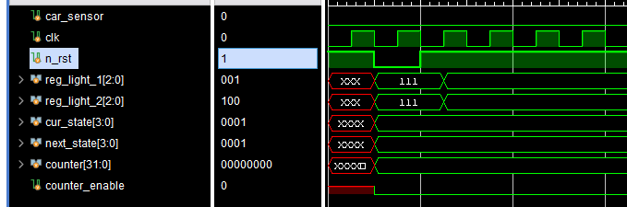
Waveform – FSM reset
The first posedge clk since n_rst leaves. The FSM begins to work.
Counter logic is disabled.
cur_state, car_sensor, counter all remain silent, FSM combi-logic remains silent. next_state holds.
cur_state holds.
Output updated to the ones for S_1. Light 1 green, light 2 red.
n_rst negedge arrives
light_1, light_2 turn all the lights on (3’b111) to check if they can be lit up properly.
cur_state is reset to S_1
next_state is set to S_1 in the combi-logic
counter is reset to 0
counter_enable is set to 0 in the combi-logic
n_rst leaves

Slide 33
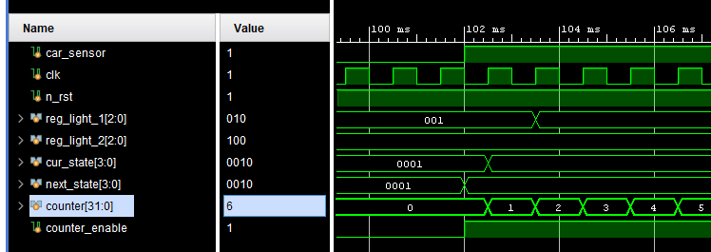
Waveform – Car comes, state change S_1 to S_2
Clock posedge arrives. FSM state changes.
cur_state = next_state (S_2). Counter starts to count.
Output updated 1 cycle later. Light 1 is yellow. Light 2 is red.
Max 2 ms lagging between car arrival event and traffic light changes.
car_sensor arrives, combi-logic triggers. next_state = S_2, counter_enable = 1’b1.

Slide 34
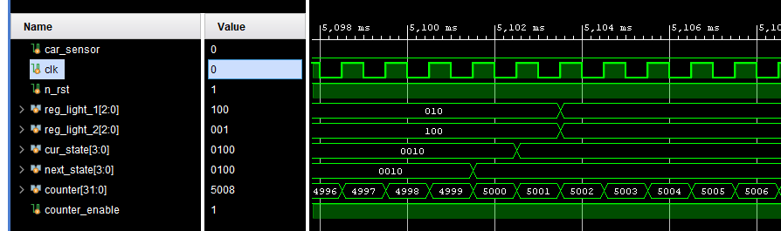
Waveform – State change S_2 to S_3
FSM changes cur_state to S_3 in the following cycle.
Counter counts 5,000 cycles (5 s).
next_state changes from S_2 to S_3.
Output changes 1 cycle later. Light 1 is red, Light 2 is green.

Slide 35
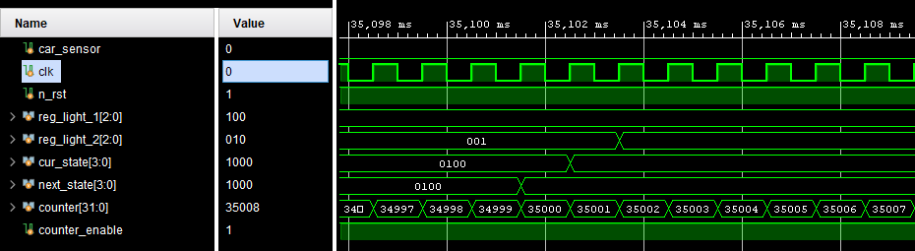
Waveform – State change S_3 to S_4
FSM changes cur_state to S_4 in the following cycle.
Output changes 1 cycle later. Light 1 is red, Light 2 is yellow.
Don’t miss it, hurry up!
Counter counts 30,000 cycles more (30 s). next_state changes from S_3 to S_4.

Slide 36
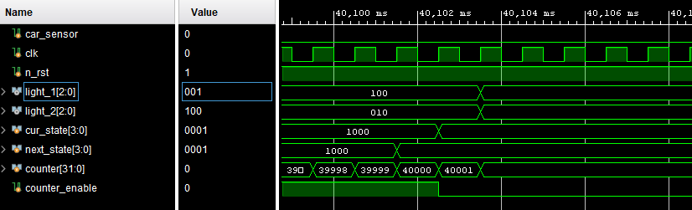
Waveform – State change S_4 to S_1
FSM changes cur_state to S_1 in the following cycle.
counter_enable set to 1’b0.
Output changes 1 cycle later. Light 1 is Green, Light 2 is Red.
Counter reset.
Back to square one.
Counter counts 5,000 cycles more (5 s). next_state changes from S_4 to S_1.
Rules of thumb No.9:
Each reg should only be driven by one always block.
Why not reset the counter directly at the combi-logic?

Slide 37

Questions?

